Slide 1
ETL Project
Presented by Robert Danielson and Navneet Gupta

Slide 2
Project Introduction
For this project, we two sources that were closely related. Both were found on Kaggle.
Our goal was to take two large data sources and find a way to place it into a sql database. To do this, we had to extract, transform, and load our sources through python code.

Slide 3
ETL Process
CSV Files
Json Files
CSV Files
Sql Databases
Spreadsheets
Data files are merged, cleaned, filtered, selected, and joined together
Load the new data files into a relational or non-relational database

Slide 4
Extract your sources.
Red Wine Quality
Description: The data source “Red Wine Quality” is a dataset pulled for statistical modeling an regression analysis. The variables given can be used to described the level of acidity in the wine. The study ranks each variable on a 1-10 scale, with 1 being a “not good” taste and 10 being a “good” taste. Best used for practice with parameters in statistical models.
File Format: CSV
Columns Used: fixed acidity, volatile acidity, citric acid, residual sugar,, chlorides, free sulfur dioxide, total sulfur dioxide, density, pH
https://www.kaggle.com/uciml/red-wine-quality-cortez-et-al-2009

Slide 5
Extract your sources.
Wine Reviews
Description: This data source was originally scraped from WineEnthusiast. It is a collection of wine products graphed by location, description, and region. The dataset is based used to find trends in wineries across the US and can be used to make predictive models based on the winery description.
File Format: CSV
Columns Used: country, description, designation, price, province, twitter handler, variety, winery
https://www.kaggle.com/zynicide/wine-reviews

Slide 6
Transform your data.
Data was edited and cleaned.
Null values were dropped in cases of unrecorded data.
Columns needed to be specified between strings and integers using sqlalchemy as the data mapper.
The pandas library was used to format, remove, and add columns.
Through the csv reader, each file was written into the tables.

Slide 7
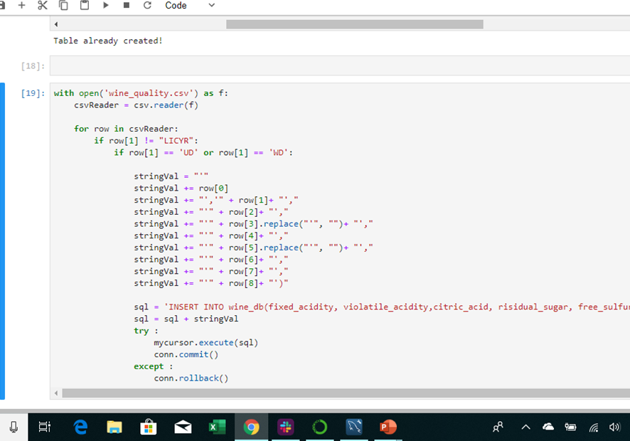
Transform your data.

Slide 8
Load your data.
Using jupyter notebook, a connection was established through mysql to transfer the data into a new relational database.
Tables were created in mysql. Jupyter notebook was used to add in existing files into each tables.
One database was created along with…
  One table for each dataset
  One table with both datasets merged together.
Conclusion: These datasets were chosen because CSV file are easy to extract. Both datasets gave us practice formatting strings and integers. Also, each CSV file was easy to write into each data frame table.

Slide 9
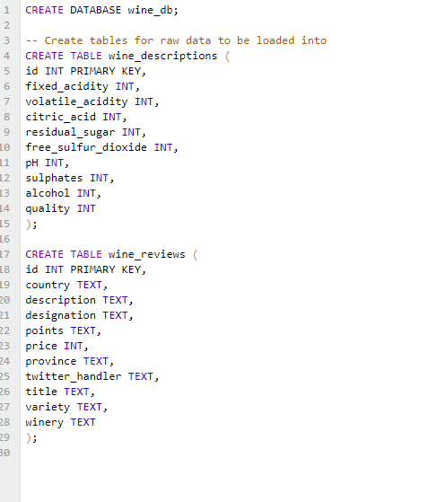
Load your data.

Slide 10
Questions?

